Slide 1


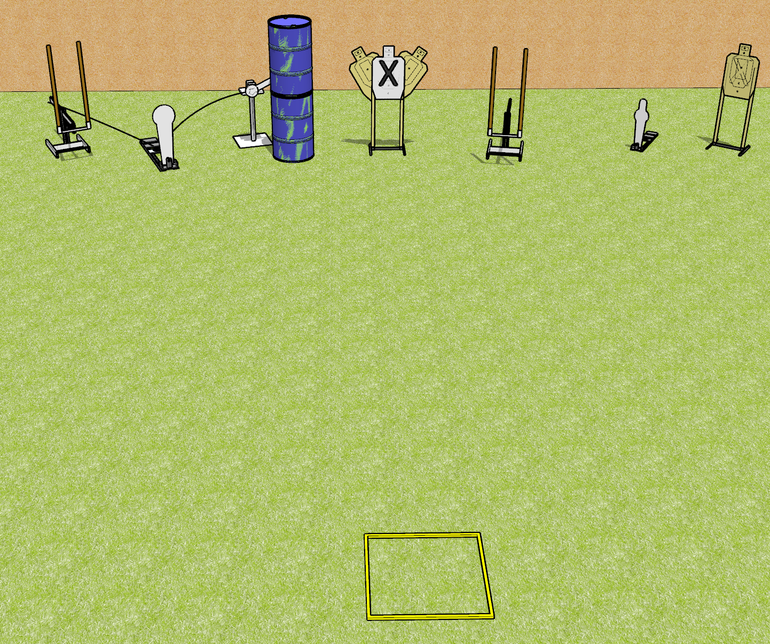
 | Dothan Gun Club – USPSA Match The One Course Designer : Drew Coleman
START POSITION : Standing in start box
GUN READY CONDITION : Pistol loaded and holstered, wrists above shoulders. PCC buttstock on belt pointed down range. |  | SCORING: Comstock, 8 rounds TARGETS: 5 paper, 3 Steel SCORED HITS: Best 1 on paper, steel until down START-STOP: Audible, last shot RULES:
STAGE PROCEDURE: Engage targets as they become available from within the fault lines

